Slide 1
Nutritional Disorders Minerals disorders
Dr. Zainab A. Al-Mayyahi
Department of Medicine
College of Medicine
University of Basrah

Slide 2
Objectives
By the end of this lecture you should be able to
Define minerals
Identify causes of minerals deficiencies
Describe the clinical features of minerals deficiency and excess
Treat minerals related nutritional disorders

Slide 3
Minerals
Minerals are required in human diet for optimal body function.
All minerals are essential.
Both deficiencies and excess of minerals can cause disease.

Slide 4
Iron
Total body iron is : 2-2.5 g in females.
3-3.5 g in males.
Majority of iron is present in hemoglobin.
Small amount present in cytochromes and myoglobin

Slide 5
Sources and daily requirements
Daily requirement : 8 mg
Sources : red meat, liver, green vegetables
90% of dietary iron is non-haem iron.
Only 30% of haem and 5% of non-haem iron is absorbed from the GIT.

Slide 6
Functions of iron
O₂ transport in the blood as part of hemoglobin.
O₂ binding to myoglobin in muscles.
Critical element in cytochrome system in mitochondria.

Slide 7
Iron deficiency
Causes of iron deficiency:
Malnutrition.
Malabsorption (celiac disease).
Achlorhydria.
Increased demand ( children, pregnancy).
Chronic bleeding.
Hook worm infestation

Slide 8
Clinical features of Iron deficiency
Iron deficiency anemia:
Fatigue, pallor, reduced exercise capacity anorexia, insomnia, pica.
Angular stomatitis, cheilosis, loss of tongue papillae.
Koilonychia (spooning of the fingernails) occur in advanced cases.
Splenomegaly may occur with severe persistent ,untreated IDA

Slide 9
Clinical features of Iron deficiency
Plummer-Vinson syndrome is a form of sever IDA that is associated with koilonychia and dysphagia (due to upper esophageal webs) also known as Paterson-Brown Kelly syndrome

Slide 10
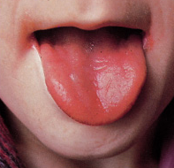
Iron deficiency

Slide 11
Diagnosis
Clinical features.
Iron studies:
Serum iron
Serum ferritin
TIBC
Transferrin saturation
BF: microcytic hypochromic
anemia

Slide 12
Treatment
Correction of the underlying cause
Iron replacement oral or parenteral.
Three months is required to replenish iron stores

Slide 13
Iron overload
Excess Iron deposition in tissues is toxic to cells, two causes of iron overload:
*Inherited autosomal recessive disease with
excess GIT absorption of iron (Hemochromatosis).
*Excess blood transfusions like in thalassemia (Hemosidrosis).

Slide 14
Clinical features of hemochromatosis
This depends on the site of iron deposition:
Skin : metallic or gray pigmentation.
Pancreas : diabetes.
Liver : cirrhosis.
Heart : cardiomyopathy.
Joints : Arthritis.

Slide 15
Diagnosis and treatment
Diagnosis:
Clinical features.
Iron studies.
Liver biopsy.
Genetic testing.
Treatment :
Phlebotomy.
Chelating agents such as deferoxamine
Treatment of damaged organs.

Slide 16
Zinc
Functions of Zinc:
An essential component of many enzymes.
Involved in protein and DNA synthesis.
Important for normal spermatogenesis and embryonic development.

Slide 17
Zinc
Sources and daily requirement:
Daily requirement is 15 mg/day.
Rich food sources are meat, shellfish, nuts, and legumes.

Slide 18
Zinc deficiency
Causes of zinc deficiency :
Diabetes mellitus.
Cirrhosis.
Alcoholism.
Malabsorption.
Sickle cell disease.
Drugs e.g. penicillamine.

Slide 19
Clinical features of zinc deficiency
Stunted growth in children.
Hypogonadism and dwarfism.
Loss of taste sensation (hypogeusia).
Hypopigmented hair.
Impaired immune function.
Dermatitis.

Slide 20
Clinical features of zinc deficiency
Acrodermatitis enteropathica a rare autosomal recessive disorder of zinc absorption presented within diarrhea, alopecia, muscle wasting, irritability, depression and skin rash.

Slide 21
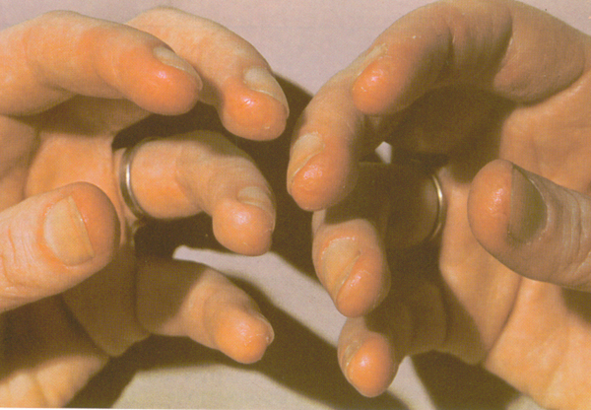

Slide 22
Zinc deficiency
Diagnosis : low serum zinc level
Treatment : 60 mg elemental zinc, orally twice a day.
Prevention : Zinc (20 mg/d) for children in developing countries where zinc deficiency is prevalent.

Slide 23
Zinc toxicity
Acute : nausea, vomiting, and fever. Zinc fumes may lead to respiratory distress.
Chronic : anemia and increase susceptibility to infections.

Slide 24
Copper
Roles of copper in the body:
Part of numerous enzyme systems.
Plays a role in iron metabolism.
Melanin synthesis.
CNS functions.
Elastin and collagen cross-linking.

Slide 25
Sources and daily requirement
Sources : shellfish, liver, nuts, legumes, meat and water.
Daily requirement : 900 μg

Slide 26
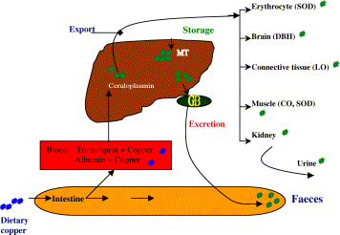
Copper metabolism
Cu
Ceruloplasmin
Blood : copper + albumin

Slide 27
Copper deficiency
Causes of copper deficiency:
Malabsorption.
Nephrotic syndrome( loss of albumin).
Chronic zinc therapy.
Inherited defects in copper metabolism.

Slide 28
Copper deficiency
Clinical features :
Rare, mainly presents with anemia, neutropenia, mental retardation and dermatitis.
Diagnosis :
low serum copper and low serum ceruloplasmin.
Treatment :
Correction of the underlying cause and copper supplements.

Slide 29
Copper toxicity
Causes of copper toxicity:
Wilson’s disease : an autosomal recessive disorder of ceruloplasmin synthesis leads to failure of copper excretion and accumulation of copper in tissues.
Primary biliary cirrhosis.
Chronic biliary obstruction.

Slide 30
Clinical features of Wilson’s disease
Organs affected are :
Eyes : brown discoloration around the cornea (Kayser Fleischer rings).
Liver : hepatitis and cirrhosis.
Kidneys : proximal tubule damage.
Basal ganglia : dementia and ataxia.
RBCs : hemolysis.

Slide 31
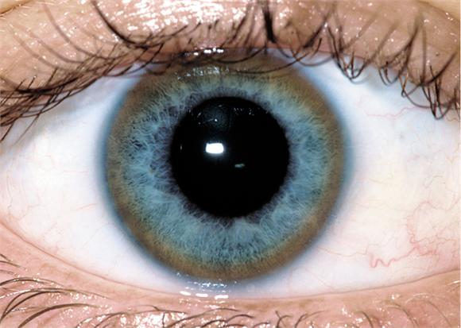

Slide 32
Diagnosis and treatment
Diagnosis :
Low serum ceruloplasmin.
Liver biopsy : high levels of copper.
Treatment:
Copper binding agents like zinc and penicillamine.

Slide 33
Iodine
Essential element in thyroid hormone synthesis.
Present in sea foods and in small amounts in soil and water.
Daily requirements: 150 μg

Slide 34
Iodine deficiency
People who live in mountains are at risk of iodine deficiency because of low iodine content of the soil .
Clinical features:
Endemic goiter with hypothyroidism.
Babies born to mothers who are iodine deficient are liable to develop cretinism.

Slide 35
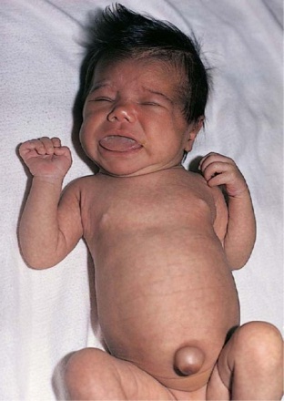
Iodine deficiency

Slide 36
Prevention and treatment
Prevention :
Iodine rich foods and iodination of salt
Treatment:
Iodine replacement and thyroxin

Slide 37
Iodine toxicity
Caused by large doses of iodine or by drugs like amiodarone.
Induce hypothyroidism by blocking thyroid hormone synthesis.

Slide 38
Selenium
Functions:
Protects proteins, lipids, and nucleic acids from oxidation.
Protective role against cancer and cardiovascular diseases.
Catalyze the conversion of thyroxine (T4) to triiodothyronine (T3).
Sources : meat, seafood, grains

Slide 39
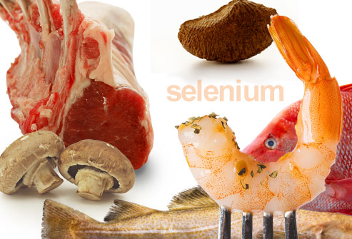

Slide 40
Selenium deficiency
Rare, presents with cardiomyopathies and myalgia.
Keshan disease is an endemic cardiomyopathy found in countries with low soil concentrations of selenium like China.

Slide 41
Diagnosis and treatment
Diagnosis:
Low selenium level.
Treatment:
Selenium supplements and management of heart failure

Slide 42
Chromium
Functions of chromium:
Potentiates the action of insulin in patients with impaired glucose tolerance.
Improve blood lipid profiles.
Protects against ischemic heart disease.

Slide 43
Sources and daily requirements
Sources : yeast, meat, and grains.
Daily requirement :20-200 μg

Slide 44
Chromium deficiency
Clinical features :
Impaired glucose tolerance and hyperglycemia.
Neuropathy and encephalopathy.
Treatment:
Chromium rich foods and chromium supplements.

Slide 45
Fluoride
Fluoride is essential for the maintenance of teeth and bone structure.
Fluoride increases teeth enamel resistance to acid.
The main source is drinking water.
Daily requirement : 3.8 mg

Slide 46
Fluoride deficiency:
Clinical features:
Increase the risk of dental caries.
Insulin resistance
Abnormal lipid profile

Slide 47
Fluoride toxicity (acute)
Presents with hypoglycemia, GIT symptoms and electrolytes disturbance like hyperkalemia, hypocalcemia and hypomagnesaemia
Seizures and cardiac arrhythmia may occur
Treatment is calcium salts

Slide 48
Fluorosis (chronic toxicity)
Excess fluoride intake results in mottling and pitting of teeth enamel.
Continuous exposure to excess fluoride may lead to brittle bones (skeletal fluorosis).

Slide 49
Manganese
It is an important activator of many enzymes which are important in nucleic acids synthesis.
Daily requirement : 2.3 mg

Slide 50
Manganese deficiency
Rare, skeletal abnormalities, poor growth, ataxia and convulsions.
Abnormal glucose tolerance and lipid profile
Treatment : oral MnCl 2 mg/ day

Slide 51
Manganese toxicity
Toxic inhalation of manganese may results in a Parkinson-like syndrome.
Treatment is symptomatic and supportive

